Slide 1

Lariat Car Rental Agency
Increasing Profitability

Slide 2

Four Strategies
Strategy 1: Increase Rental Prices

Slide 4

Four Strategies
Strategy 2: Expand to More Locations

Slide 6

Four Strategies
Strategy 3: Cut Costs by Getting Rid of Certain Vehicles

Slide 8
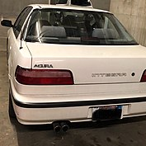
Strategy 3

Slide 10

Four Strategies
Strategy 4: Combine Strategies 1, 2, and 3

Slide 11
Combine All Strategies to Profit

Slide 15

Time to Grow and Profit

